Slide 1
Make connections through personal experiences
Name: Anderson Rene Gomez Aza
Group: S8A
Signature: English VI
Escuela Tecnológica Instituto Técnico Central

Slide 2



For My Job

Slide 3
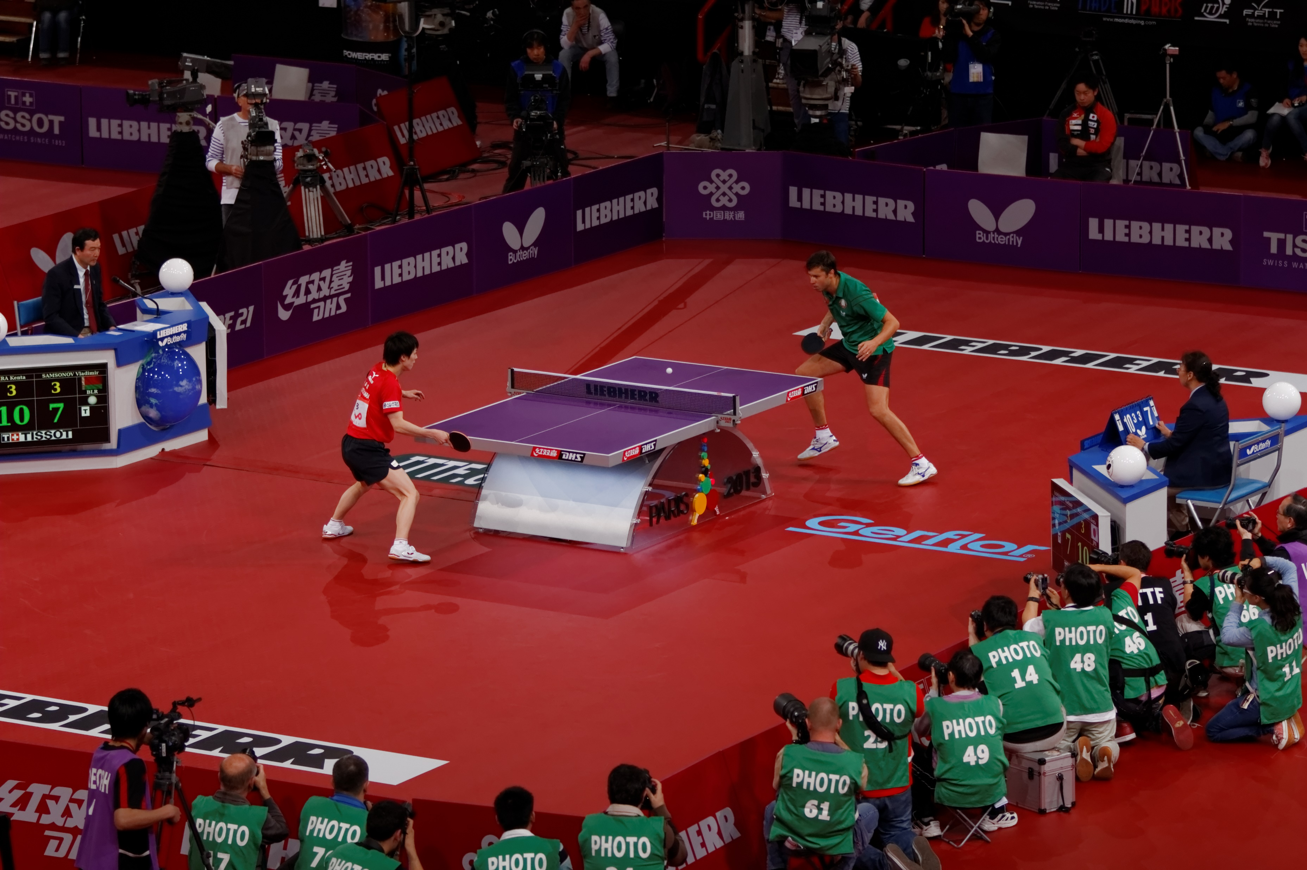
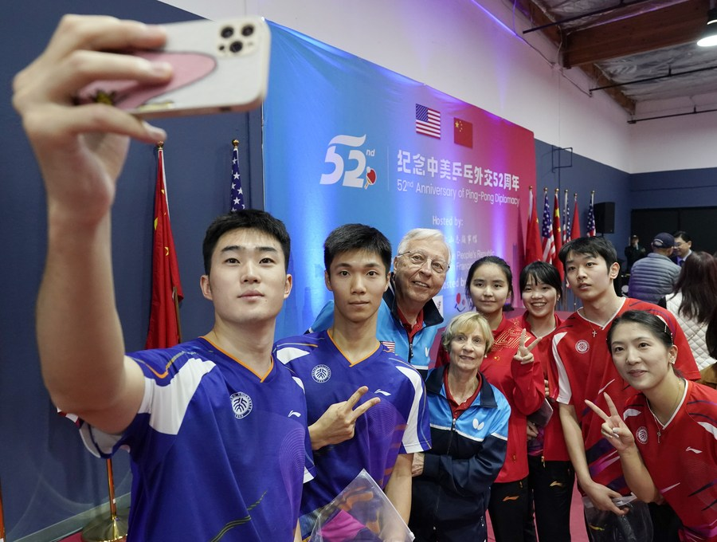

For My Favorite Sport

Slide 4
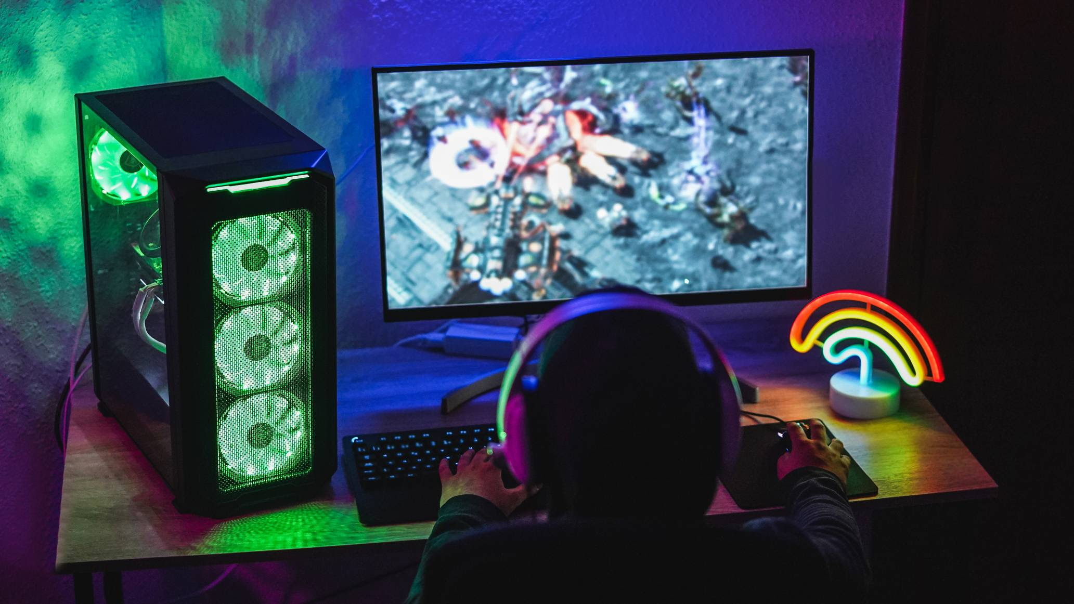


For Video Games

Slide 5


